Slide 1
INTER-VLAN ROUTING
Routing on-a-stick

Slide 2
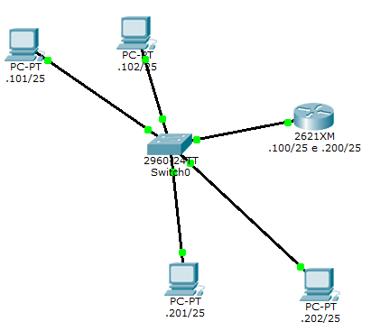
Target
InterVLAN routing tra VLAN 10 e VLAN 20 tramite il router con una sola interfaccia ethernet

Slide 3
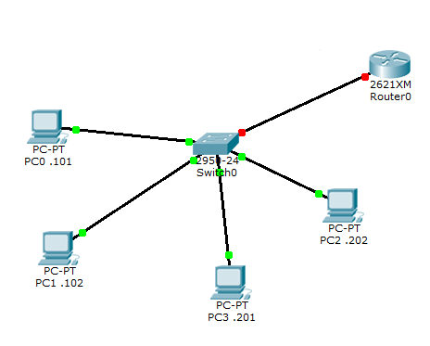
STEP #1
PC’s addresses:
192.168.0.101/25
192.168.0.102/25
192.168.0.201/25
192.168.0.202/25

Slide 4
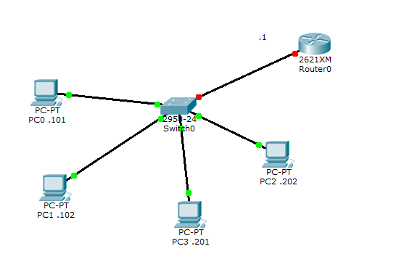
STEP #2
VLAN
(switch, config mode)
VLAN 10
VLAN 20

Slide 5
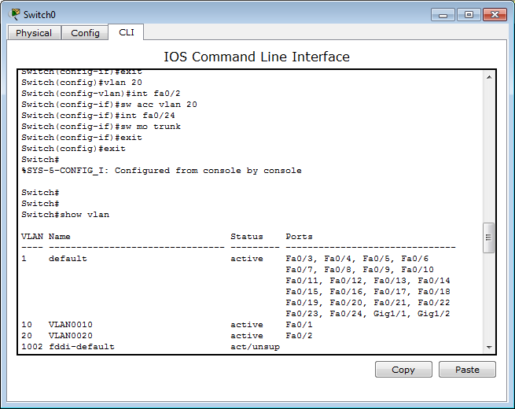
STEP #3
Port’s config
Access VLAN 10:
Int fa0/1
Int fa0/3
Access VLAN 20:
Int fa0/2
Int fa0/4
Trunk:
Int fa0/24

Slide 6
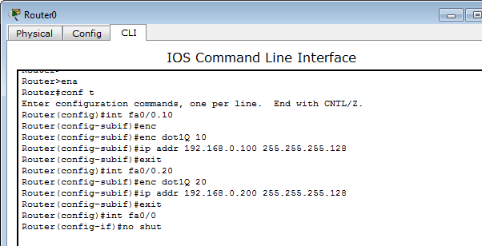
STEP #4: router’s config
Subinterfaces:
Encapsulation dot1Q
IP address
No shutdown
Router(config)# interface fastEthernet 0/0.10
Router(config-subif)# encapsulation dot1Q 10
Router(config-subif)#ip addr 192.168.0.100 255.255.255.0
Router(config)# interface fastEthernet 0/0.20
Router(config-subif)# encapsulation dot1Q 20
Router(config-subif)#ip addr 192.168.0.100 255.255.255.0
Router(config-subif)#exit
Router(config)# interface fastEthernet 0/0
Router(config-if)#no-shut

Slide 7
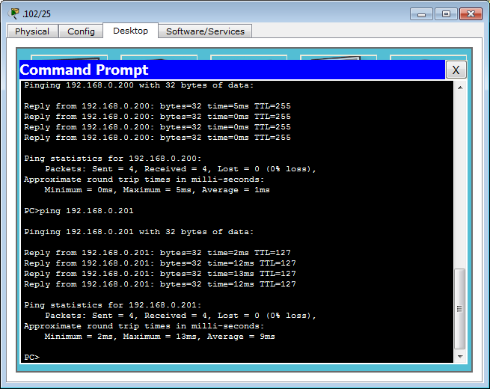
STEP #5: PING...

Slide 8
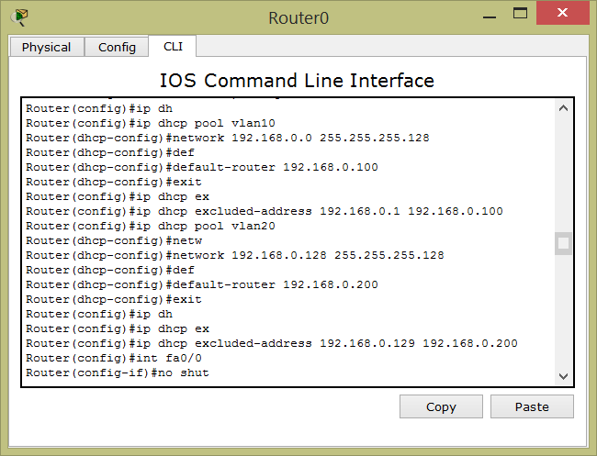
Extra: ripasso comandi DHCP

